Slide 1

Java API for JSON
Dima Ionut Daniel

Slide 2
Contents
What is JSON?
RFC 4627
JSON Java libraries
Java API for JSON - JSR 353
JSR 353 implementations
Conclusions
Bibliography

Slide 3

What is JSON?
JSON(JavaScript Object Notation) is a text-based open standard format.
The JSON format is described into RFC 4627.
This format is used for transmitting structured data over a network connection, between a client/server application.

Slide 4
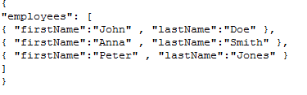
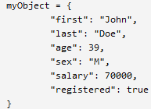

RFC 4627
JSON can represent 4 primitive types: strings, numbers, Booleans and nulls.
Objects are an unordered collection of 0 or more name/value pairs.
JSON design goals were: portable, human-readable, minimal.
JSON default encoding is UTF-8. JSON can be represented using: UTF-8,UTF-16,UTF-32, Unicode.
The MIME media type for JSON is application/json.

Slide 5
JSON Java libraries
There are Java libraries that enables the JSON operations like parsing and creation:
Json-lib
Json-simple
Jettison
Jackson
Google-gson
Flexjson
Jsonmarshaller
Xstream

Slide 6
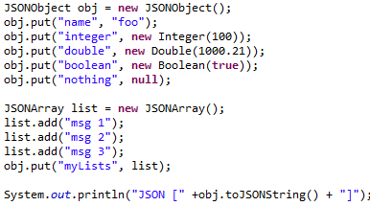
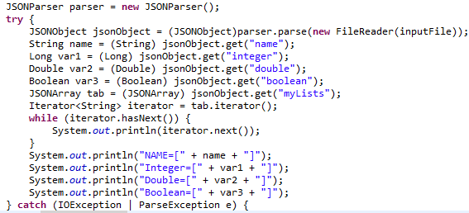
JSON Java libraries
Json-Simple
Full compliance with RFC4627
No dependency on external libraries
Easy to use
Supports custom serialization using the JSONAware interface

Slide 7
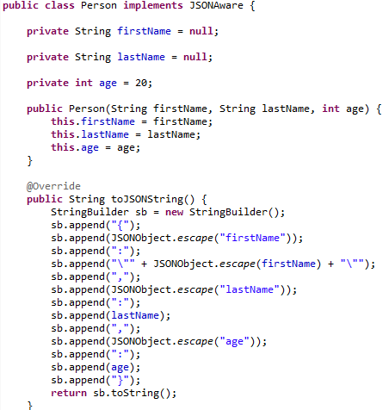
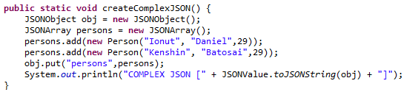
JSON Java libraries

Slide 8
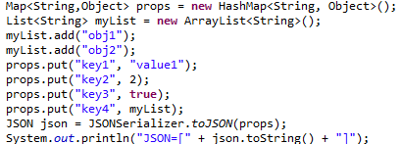
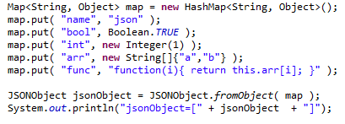
JSON Java libraries
Json-lib
Dependency needed if working with XML and Groovy: commons-lang, commons-beanutils, comons-collections, commons-logging, ezmorph.
Supports custom serializations. Allows properties filtering
Output→

Slide 9
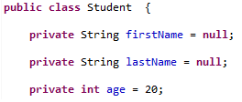

JSON Java libraries

Slide 10
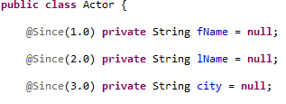
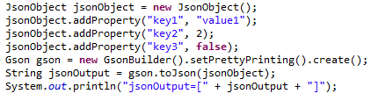
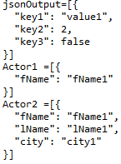

JSON Java libraries
Google-gson
Extensive support of Java Generics
Supports custom serializations
Version support
Fields filtering during JSON conversion
Pretty formatting

Slide 11
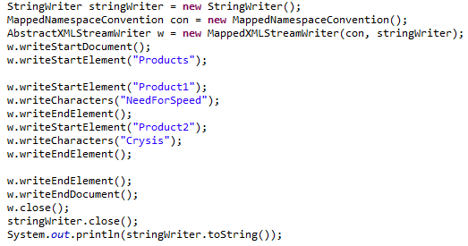
JSON Java libraries
Jettison
uses BadgerFish (convention for mapping JSON to XML).
was developed for usage in XFire and CXF to enable JSON ws.
Reads/creates JSON objects using custom STaX implementation.

Slide 12
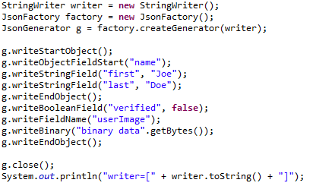
JSON Java libraries
Jackson
Multi-purpose Java library for JSON processing
Contains following APIs: Streaming API, Tree Model, Data Binding.

Slide 13
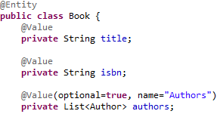
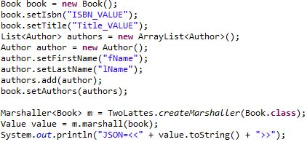
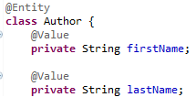

JSON Java libraries
Jsonmarshaller
Java 1.5 marshalling/unmarshalling JSON to POJO.

Slide 14
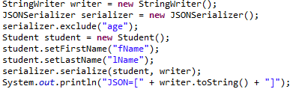
JSON Java libraries
Flexjson
light library for POJO to JSON mapping.
properties filtering during JSON conversions.
Allows custom transformers for JSON conversion like: types, classes.

Slide 15
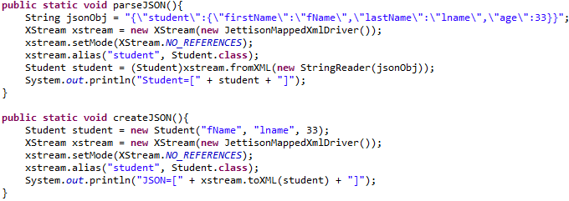
JSON Java libraries
Xstream
Xstream is a simple library for XML to POJO mapping.
Uses Jettison for JSON custom processing.
Easy to use
Has custom drivers for JSON processing

Slide 16
Java API for JSON – JSR 353
JSON-P offers both object oriented and stream based approaches, in this post I will introduce the stream APIs.
Java will have a standard set of APIs for processing JSON as part of Java EE 7.
It includes
streaming API to produce/consume JSON (similar cu StAX)
object model API to represent JSON
javax.json.stream.JsonGenerator creates JSON objects very easy.
javax.json.stream.JsonParser provides a depth first traversal of events corresponding to the JSON structure.
JsonProvider is searching for JSON providers using ServiceLoader mechanism.
JSONP tries to find custom providers or will load the "org.glassfish.json.JsonProviderImpl" as default.
The Object Model API core classes include JasonObject and JsonArray as well as JsonBuilder, JsonReader, and JsonWriter.

Slide 17
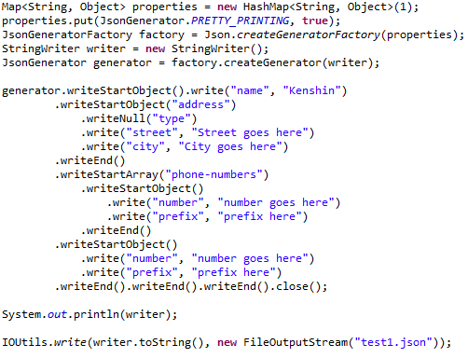
Java API for JSON – JSR 353
Bellow example shows how to create a JSON complex object using JSON Stream API.

Slide 18
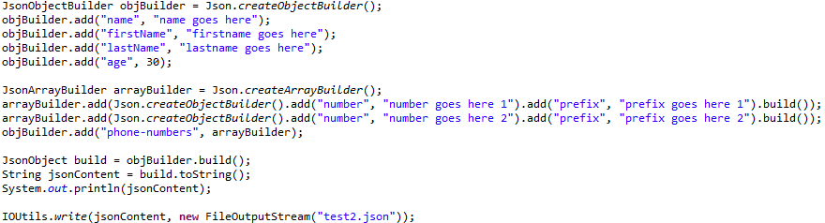
Java API for JSON – JSR 353
Bellow example shows how to create a JSON complex object using JSON Object API.
javax.json.Json is a core class because using we can create different builder starting from it.

Slide 19
JSR 353 implementations
Glassfish 4 provides a default implementation named JSONP:
version=1.0-b06
groupId=org.glassfish
artifactId=javax.json

Slide 20
Conclusions
PROS:
JSON is smaller than XML, and faster and easier to parse.
JSON is language independent.
JSON is "self-describing" and easy to understand.
JSON is lightweight text-data interchange format.
Very good support by all browsers.
Supported by many AJAX toolkits and JavaScript libraries.
CONS:
No namespace support, hence poor extensibility.
Limited development tools support.

Slide 21

Bibliography
http://en.wikipedia.org/wiki/JSON
http://www.ietf.org/rfc/rfc4627.txt
http://www.w3schools.com/json
http://myarch.com/json-pros-and-cons
http://www.jsonexample.com/
http://code.google.com/p/json-simple/
http://jettison.codehaus.org/
http://xstream.codehaus.org/json-tutorial.html
http://java.dzone.com/articles/java-api-json-processing-jsr

